Slide 1
Insurance Premium Prediction

Slide 2
Objective
Objective of the project is to calculate the insurance premium charges

Slide 3
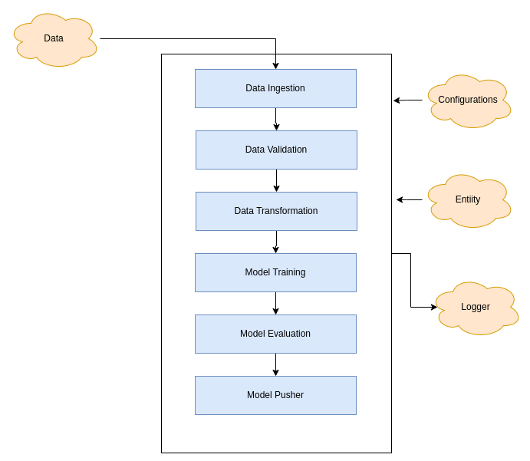
Architecture

Slide 4
Data Ingestion
Here we will download the dataset from the repo
We will split it to test and train data frame
Data Validation
Will do the validation
We shall ensure that the features are same
We shall ensure the datatypes are matching
We shall ensure categories are matching

Slide 5
Data Transformation
Here will do the transformation
Empty values shall be replaced with the median for integer/float datatypes and for the category it shall be replaced with most frequent
Model Training
In model training, We shall run the model based on the configuration
We shall be adding multiple regression model configuration
Based on the best accuracy, we shall be selecting the model

Slide 6
Model Evaluation
Model shall be evaluated for train and test data
New model shall be compared with the last model and based on the performance we shall be selecting the model
After model evaluation it was found that the RandomForest is giving more accuracy than the Linear Regression.
Model Pusher
Once the new model has higher accuracy, it shall be pushed to the location

Slide 7
Performance Metrics
Model
Random Forest
Train Score | Test Score | Average Score
0.889 | 0.886 | 0.887

